Slide 1
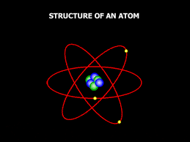
What are the Pieces of an Atom?
Protons p+
Neutrons n
Electrons e-

Slide 2
How do they compare? (Mass)
Proton Mass = 1.7 x 10⁻²⁷ kg
Neutrons Mass = 1.7 x 10⁻²⁷ kg
Electrons Mass = 0.0009991 x 10⁻²⁷ kg
Look at how these number compare

Slide 3
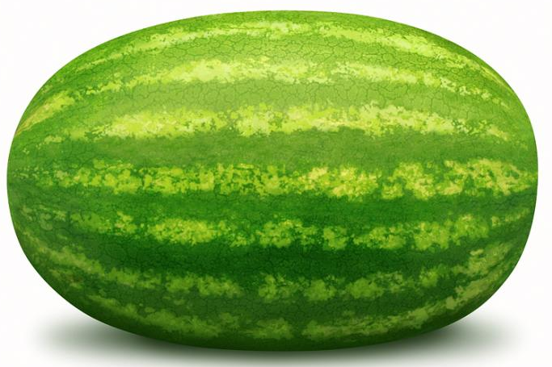


How do they compare? (Mass)
Proton | Neutron | Electron
Watermelon | Watermelon | Grape

Slide 4

How do they compare? (Electric Charge)
Neutrons Charge = 0 (Neutral)
Proton Charge = +1
Electrons Charge = -1
Protons & Electrons have opposite charge

Slide 5
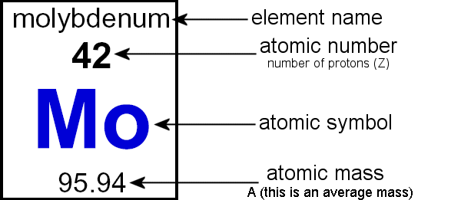
•Atomic number: number of protons in an atom, = number of electrons in electron cloud
• Atomic mass: number of protons plus neutrons
• Most common ions

Slide 6
An element has 32 protons and 31 neutrons:
What is it?

Slide 7
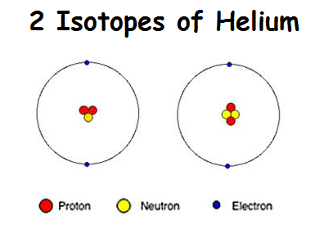
What is an Isotope?
Atoms of the same Element
With differing numbers of Neutrons
What is different about the two Helium Isotopes?
What is the same for the two Helium Isotopes?

Slide 8
What is an Isotope?
Atoms of the same Element
With differing numbers of Neutrons
What is different about the two Helium Isotopes?
The number of Neutrons (shown in Yellow)
What is the same for the two Helium Isotopes?
The number of electrons and the number of protons.

Slide 9
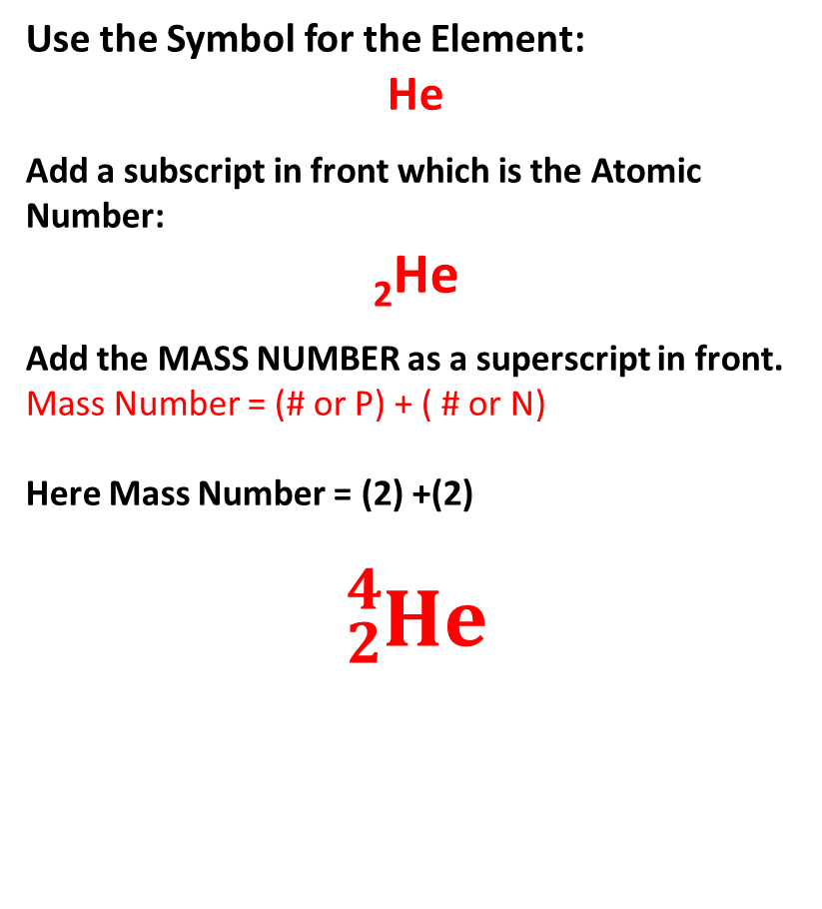
What is an Isotope?
What are the symbols for this Isotopes?
Use the Symbol for the Element:
He
Add a subscript in front which is the Atomic Number:
₂He
Add the MASS NUMBER as a superscript in front.
Mass Number = (# or P) + ( # or N)
Here Mass Number = (2) +(2)
$${}_{2}^{4}{He}$$

Slide 10
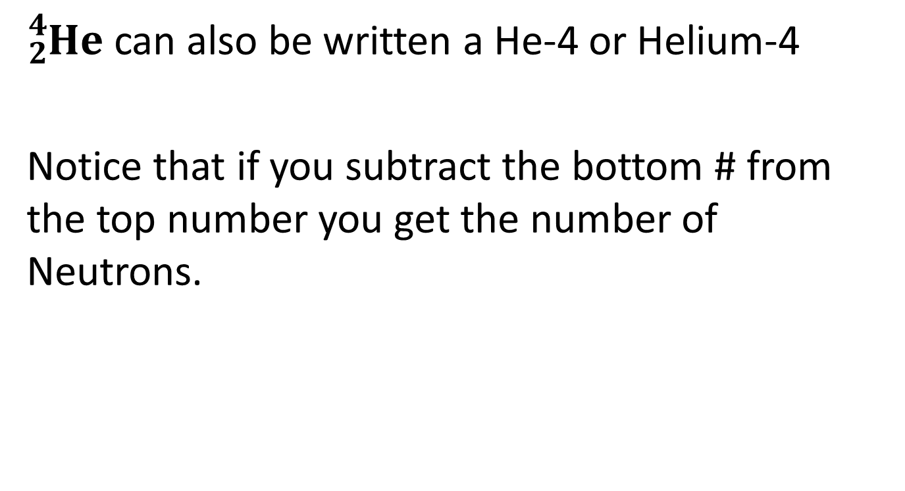
${}_{2}^{4}{He}$ can also be written a He-4 or Helium-4
Notice that if you subtract the bottom # from the top number you get the number of Neutrons.

Slide 11
Atomic Symbols for Isotopes: 2 Ways
Show the name of the element, a hyphen, and the mass number: sodium-23, sodium-24
or show the mass number and atomic number in symbol form
mass number
²³ Na
atomic number ¹¹

Slide 12
Isotopes?

Slide 13
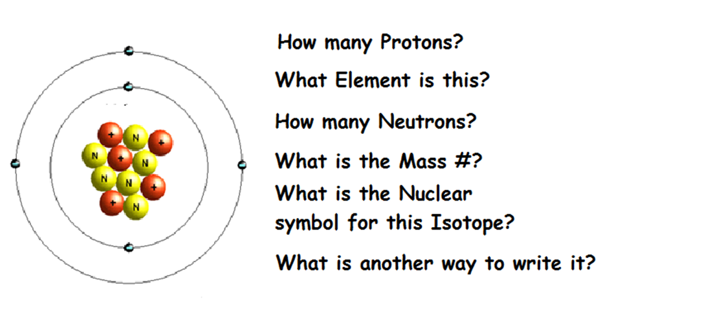
Try this one:

Slide 14
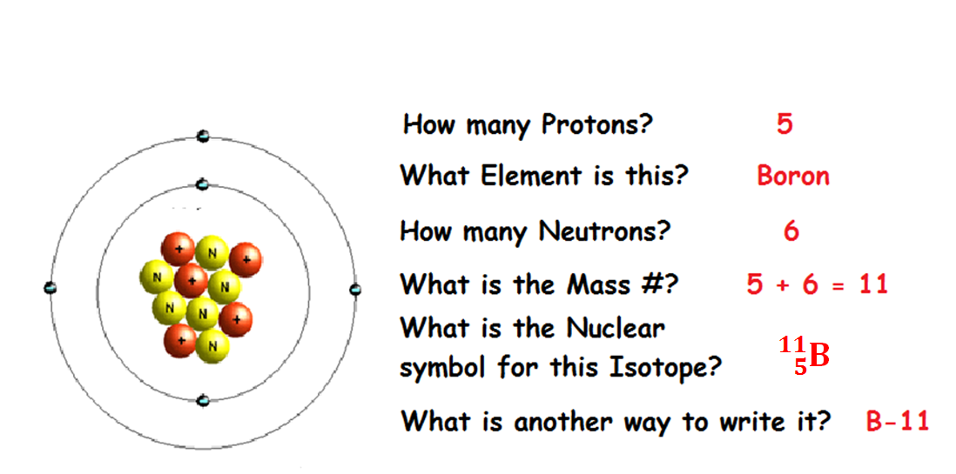
Try this one:

Slide 15
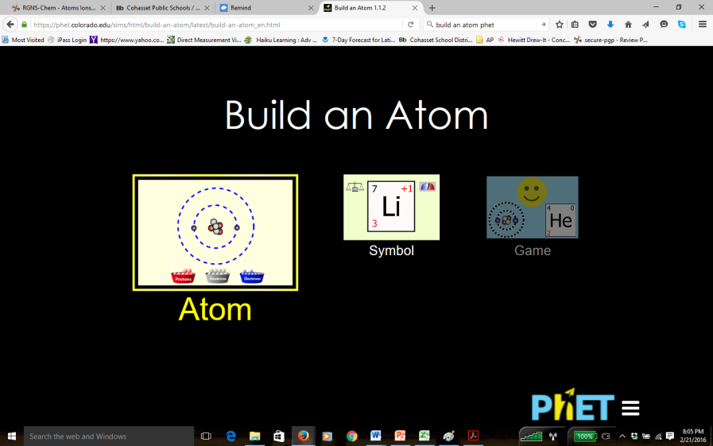
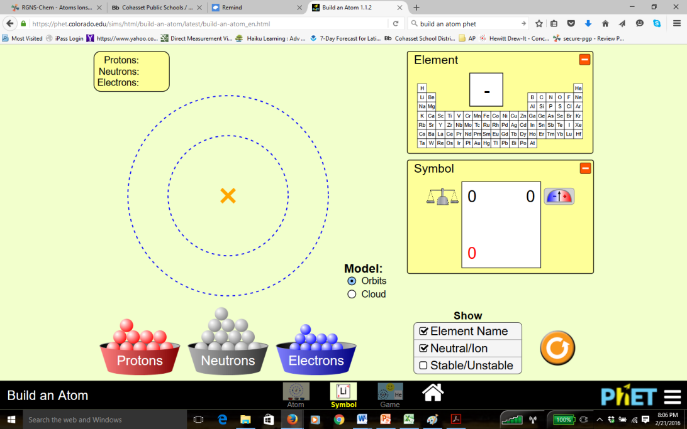
What makes an Isotope Stable.
For the answer to this visit the https://phet.colorado.edu/en/simulation/build-an-atom
Or to a Search for: phet Build and Atom

