Slide 1
Review Electron
Electrons are found in the electron cloud
Negative charge
In a neutral atom the # of protons = the # electrons
The electron cloud has very little mass (low density, large volume); therefore, the atom is considered to be primarily empty space.

Slide 2

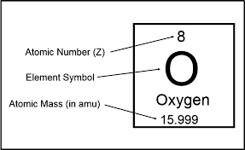
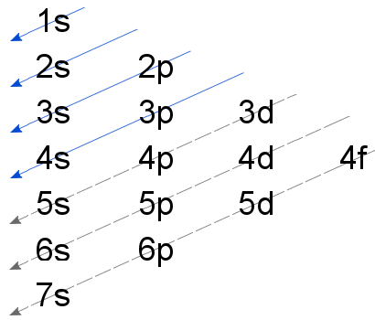

Slide 3
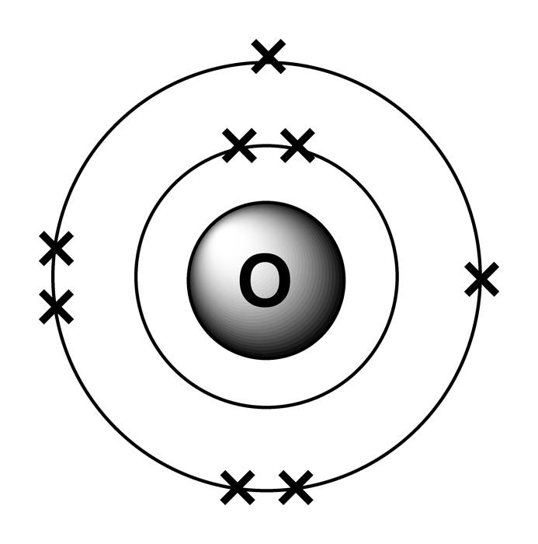
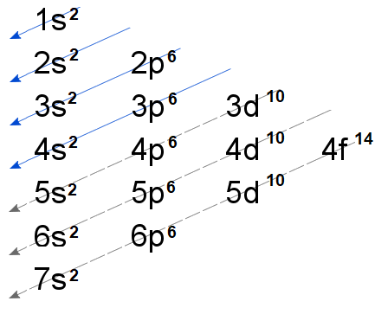
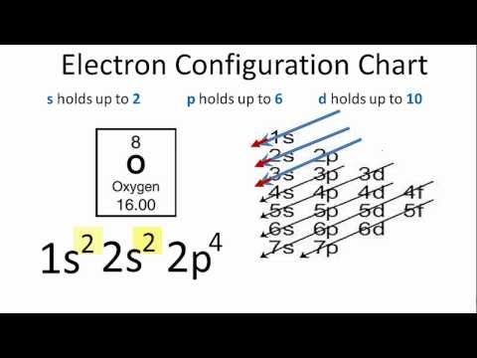

Slide 4

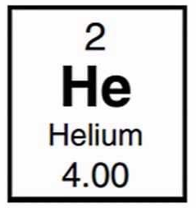
Another example!!!

Slide 5
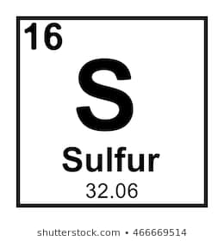

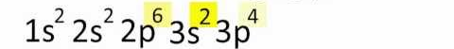
Another example!!!
=16

Slide 6
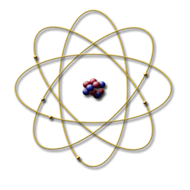

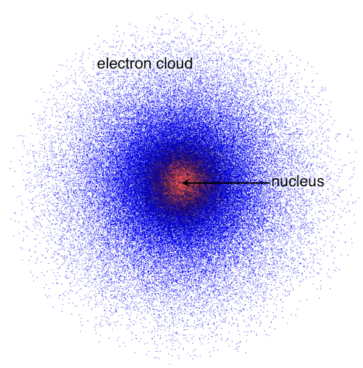
Review of Electron Cloud Model (Wave Mechanical Model)
In the wave-mechanical model (electron cloud model), the electrons are in orbitals, which are defined as the regions of the most probable electron location

Slide 7

Electron Configuration
Electron configuration is a condensed way of representing the pattern of electrons in an atom.
For oxygen: 2-6 (2 electrons in first shell, 6 in second shell)

Slide 8
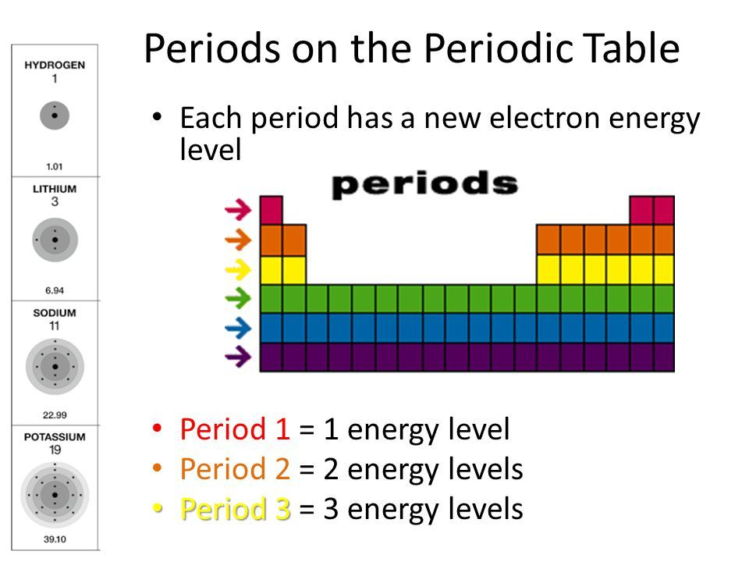

Slide 9

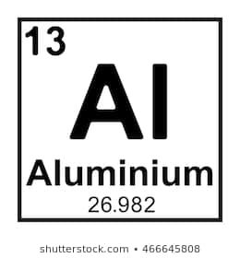

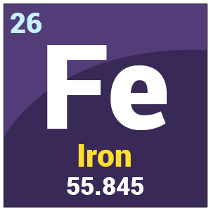
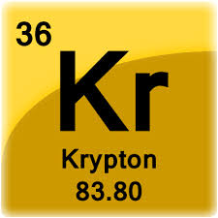
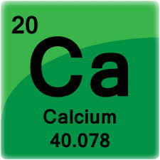
Let’s Practice

Slide 11
Sub-levels = Specific Atomic Orbitals
Each shell may have several subshells with several orbitals
Each energy level has 1 or more “sub-levels” which describe the specific “atomic orbitals” for that level.
  n = 1 has 1 sub-level (the “s” orbital)
  n = 2 has 2 sub-levels (“s” and “p”)
  n = 3 has 3 sub-levels (“s”, “p” and “d”)
  n = 4 has 4 sub-levels (“s”, “p”, “d” and “f”)
There are 4 types of atomic orbitals:
  s, p, d and f
  Each of these sub-levels represent the blocks on the periodic table.

Slide 12
Energy Level | Sub-levels | Total Orbitals | Total Electrons | Total Electrons per Level
n = 1 | s | 1 (1s orbital) | 2 | 2
n = 2 | s p | 1 (2s orbital) 3 (2p orbitals) | 2 6 | 8
n = 3 | s p d | 1 (3s orbital) 3 (3p orbitals) 5 (3d orbitals) | 2 6 10 | 18
n = 4 | s p d f | 1 (4s orbital) 3 (4p orbitals) 5 (4d orbitals) 7 (4f orbitals) | 2 6 10 14 | 32
Notes:
Copy table. The first energy level or shell has 1 sublevel. The second shell has 2 sublevels, the 3 shell has 3 sublevels, the 4 shell has 4 sublevels

Slide 13
Example Electron Configuration with orbitals for Oxygen
Oxygen has 8 electrons
Electron configuration for O is 2-6 (2 electrons in the first shell and 6 in the second
1s² 2s²2p⁴
2 e- in first shell
Total of 6 e- in second shell
second shell
first shell
subshells

Slide 14
Orbital notation
Orbital notation- a shell or energy level is indicated by a number, but the shells are subdivided by subshells.

Slide 15
Atomic Orbitals
An atomic orbital is thought of as the region of space in which there is a high probability of finding an electron
The energy levels of electrons are labeled by principal quantum numbers (n) or shells. (ground state)
The ground state is the state of the electron when it is not excited(normal state) as shown in periodic table.
)1 )2 )3 )4
nucleus

Slide 16
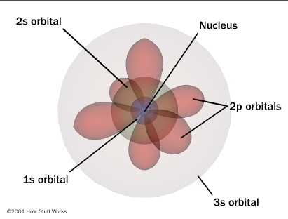
Magnesium 2-8-2
1s²2s²2p⁶3s²

Slide 17
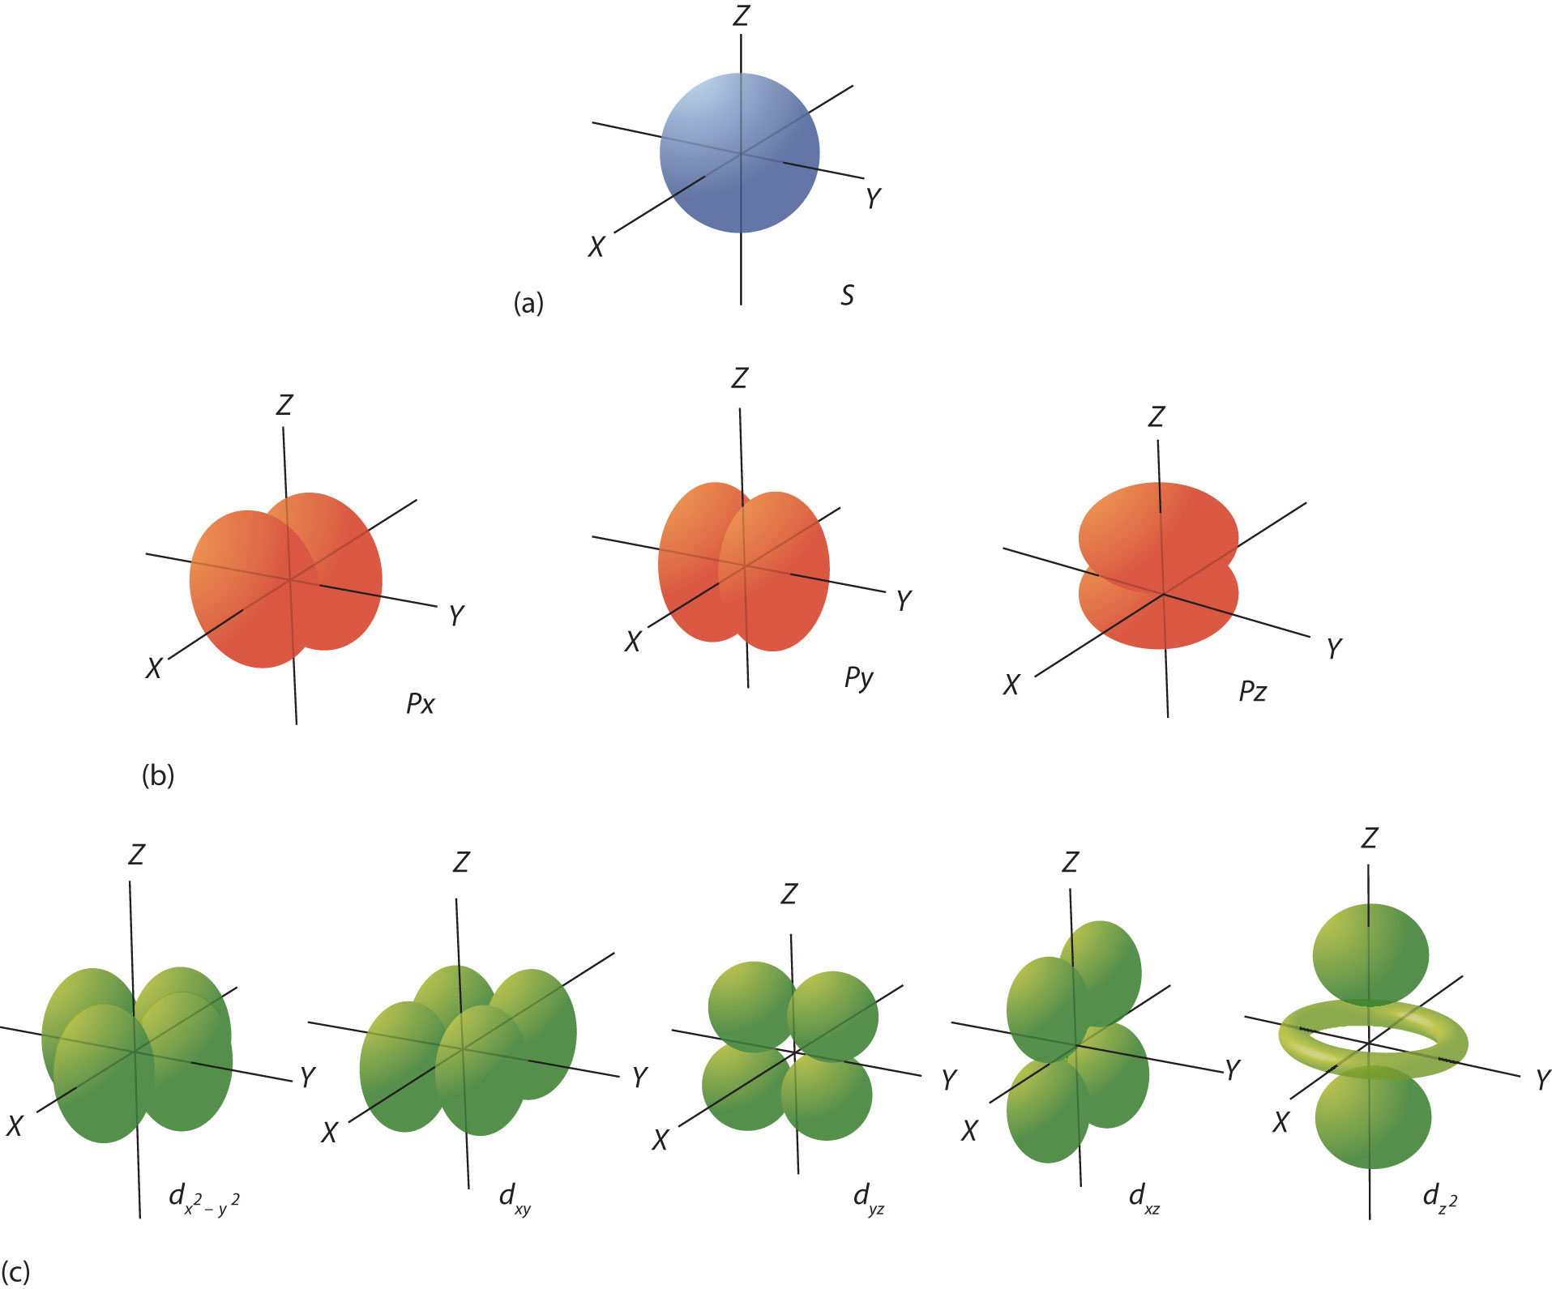
Atomic Orbital shapes

Slide 18
Orbital notation
The s sublevel has one orbital
The p sublevel has 3 orbitals
And the d sublevel has 5 orbitals

Slide 19
Orbital notation
Orbitals can hold a maximum of two electrons
Magnetic attraction holds the electrons together. The opposite magnetic attraction overcomes the charge repulsion of the two electrons in an orbital.
s
p
d
* Each underline represents an orbital and each arrow represents an electron*

Slide 20
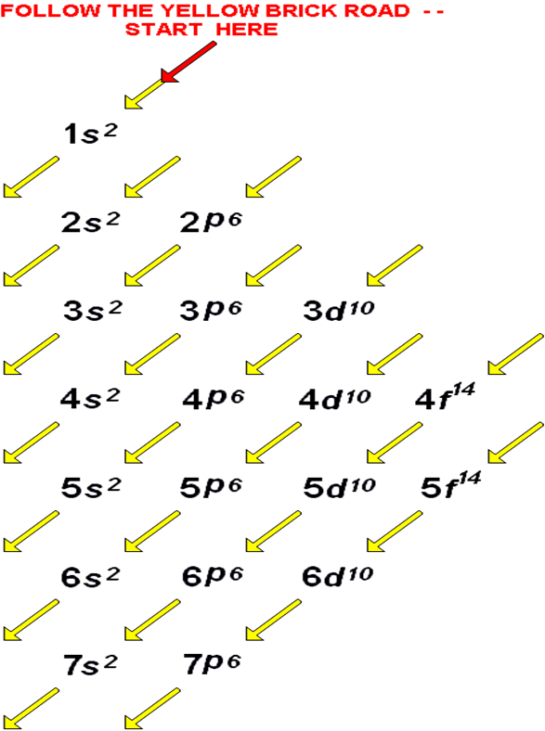
Rules for Filling Out Orbital Diagram
Use the orbital filling diagram at the right to help you figure out HOW to write them
  Start with the 1s orbital. Fill each orbital completely and then go to the next one, until all of the elements have been accounted for.
Fill Lower Energy Orbitals FIRST
No more than 2 Electrons in Any Orbital…ever.
Notes:
Copy Orbital Filling Diragram

Slide 21
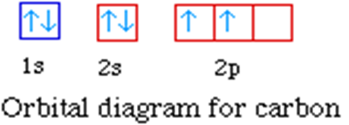
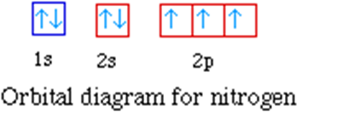
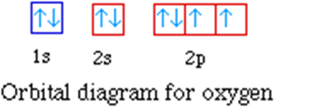
Rules for Electron Configuration Cont.
When you fill orbitals, you fill them all half way first, and then you start pairing up the electrons.

Slide 22
Electron Configurations
Element | Configuration | Element | Configuration
H Z=1 | 1s¹ | He Z=2 | 1s²
Li Z=3 | 1s²2s¹ | Be Z=4 | 1s²2s²
B Z=5 | 1s²2s²2p¹ | C Z=6 | 1s²2s²2p²
N Z=7 | 1s²2s²2p³ | O Z=8 | 1s²2s²2p⁴
F Z=9 | 1s²2s²2p⁵ | Ne Z=10 | 1s²2s²2p⁶ (2p is now full)
Na Z=11 | 1s²2s²2p⁶3s¹ | Cl Z=17 | 1s²2s²2p⁶3s²3p⁵
K Z=19 | 1s²2s²2p⁶3s²3p⁶4s¹ | Sc Z=21 | 1s²2s²2p⁶3s²3p⁶4s²3d¹
Fe Z=26 | 1s²2s²2p⁶3s²3p⁶4s²3d⁶ | Br Z=35 | 1s²2s²2p⁶3s²3p⁶4s²3d¹⁰4p⁵
Note that all the numbers in the electron configuration add up to the atomic number for that element. Ex: for Ne (Z=10), 2+2+6 = 10

Slide 23
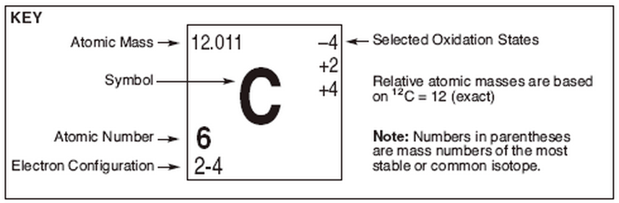
Lets Practice
Electron Configuration: 2-4
2 electrons in the first shell and 4 electrons in the second shell
Orbital notation:
1 s² _____
2 s² _____
2 p² ______ _______ _______
1s² 2s² 2p²

Slide 24
Lets Try…….
Fluorine
  Electron configuration is 2-7
    2 electrons in the first shell and 7 electrons in the second
    Reminder: the first shell only has the s sublevel and the s sublevel has only 1 orbital. The second shell has the s and p sublevel; the sublevel has 1 orbital and the p sublevel has 3 orbitals. Each orbital can hold 2 electrons
Orbital notation:
1 s² _____
2 s² _____
2 p⁵ ______ _______ _______
1s² 2s² 2p⁵

